Slide 1
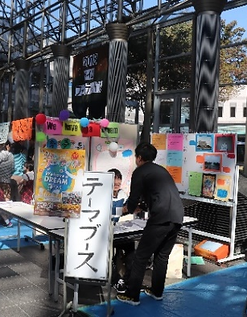
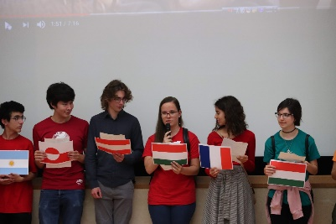
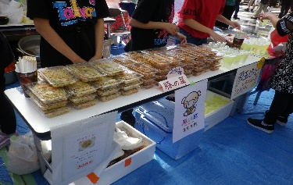
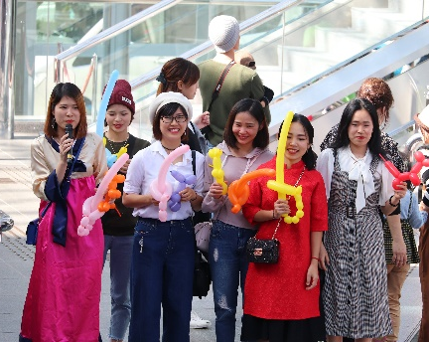
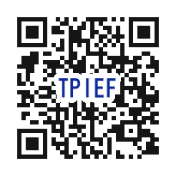
Deadline (Fri) 26 July
Individuals
& Groups
Wanted!
31st Annual（2019）
TIME Festival
Join us & showcase your nation or organisation
An event to mingle with intercultural exchange groups & the prefecture’s foreign residents
Content
Fees
International Village
Group showcase,
exhibit, refreshments
Performances
Ethnic song/dance
International Village
Refreshments/goods booths:
\3000 gen.; \1500 student
Exhibit only: \1500 (students free)
Performances No fees
Sponsored by the TIME Festival Executive Committee (co-sponsored by TPIEF)
Opening:11am-3:30pm (Mon. holiday) 14 October
Venue：Torigin Bunka Kaikan (101-5 Shoutoku-cho)
For info contact TPIEF
TEL 0857-51-1165 FAX 0857-51-1175
E-mail: kohakura-y@torisakyu.or.jp
Help also wanted
with preparing &
setup on the day
of the event
Send us your completed registration form by email or fax.
Forms are available for download on our web site.
http://www.torisakyu.or.jp/en/

